Slide 1
MB - Maze Ball
Olivia gonzalez

Slide 2
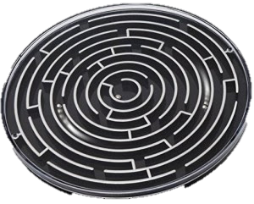
Story/Objective
Escape the mazes
You can only control the world by tilting so you must guide world around the ball.
Solve puzzles and escape

Slide 3
Functional Item
Items that unlock the next level
Platforms to hit or stay on for x amount of time before moving on
Pick up, put down items
Match similar items

Slide 4
Challenge
Puzzles
Timed puzzles
Death traps

Slide 5
Controls
WASD for the world tilting
Other keys & mouse to interact with the UI

Slide 6
Design
Simplistic and minimalistic
Blocked out colours
Varity of different level themes (forest, underwater etc.)

